Slide 1
An Investigation of Homoclinic Orbits in the Circular Restricted Three-Body Problem
Luke Bury & Don Kuettel
05/02/18

Slide 2
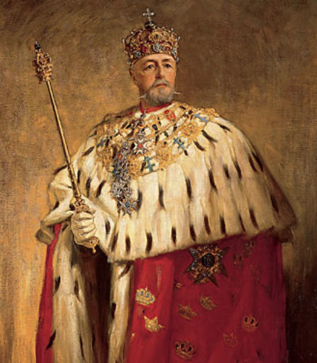
The Competition
Acta Mathematica, 1885
4 problems
[*2]https://commons.wikimedia.org/wiki/File:Oscar_II_of_Sweden_painted_by_Oscar_Bj%C3%B6rck_(original).jpg
Notes:
-Sponsored by the King of Sweden

Slide 3
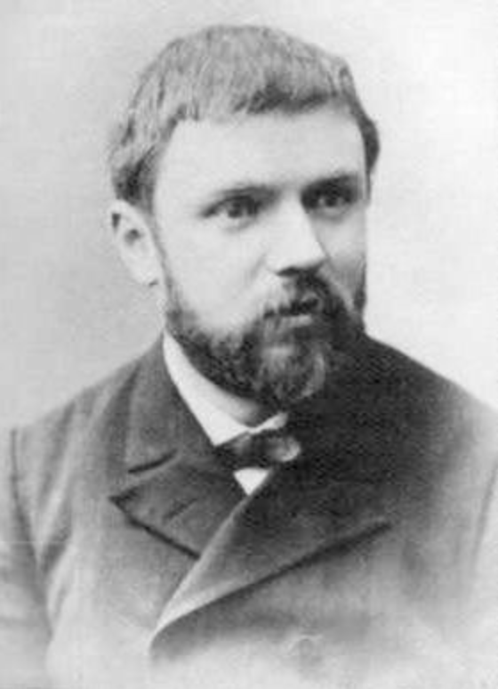
Henri Poincaré (1854-1912)
”Monster of mathematics”
https://en.wikipedia.org/wiki/Henri_Poincare

Slide 4
Henri Poincaré (1854-1912)
”Monster of mathematics”
World renown for contributions to:
Celestial mechanics
Fluid mechanics
Electricity
Thermodynamics
Chaos theory
Quantum Theory
Many more…
https://en.wikipedia.org/wiki/Henri_Poincare

Slide 5
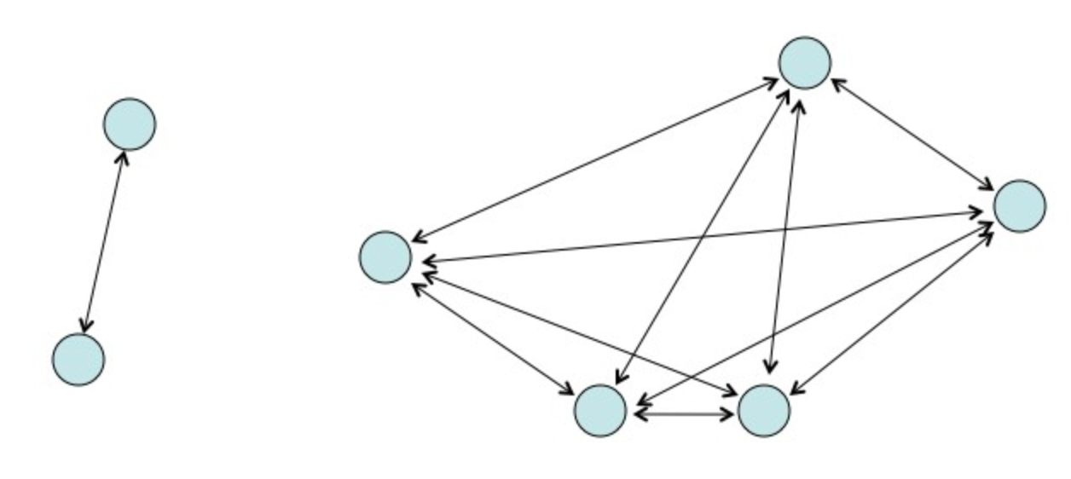
The Competition
Solve the N-Body Problem
Poincaré went for the Circular Restricted Three Body Problem (CR3BP)
Submitted and won
Critical error discovered
Discovery of Homoclinic Orbits
[*2]https://commons.wikimedia.org/wiki/File:Oscar_II_of_Sweden_painted_by_Oscar_Bj%C3%B6rck_(original).jpg
[*3] - http://www.askamathematician.com/2011/10/q-what-is-the-three-body-problem/
Notes:
-Sponsored by the King of Sweden

Slide 6
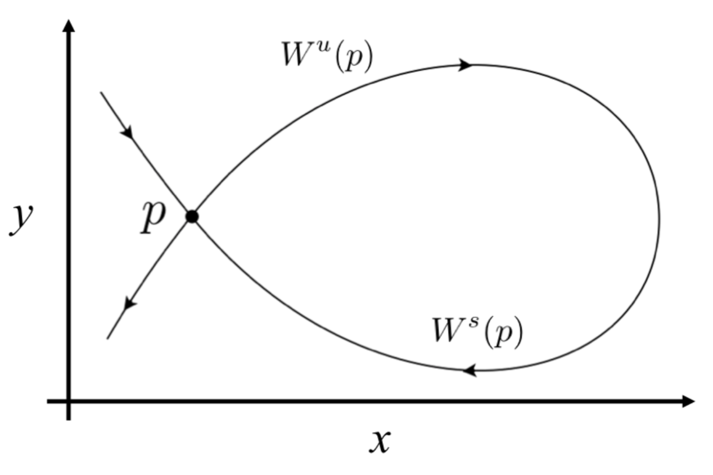
Homoclinic Orbits
A trajectory which joins a saddle equilibrium to itself
A union between a stable and unstable manifold
Orbit approaches P at both (+)∞ and (–)∞

Slide 7
Locating Homoclinic Orbits – High Level
Periodic orbits (PO)
Stable and unstable manifolds
Poincaré sections
Homoclinic points
Notes:
Basically the Intro slide

Slide 8
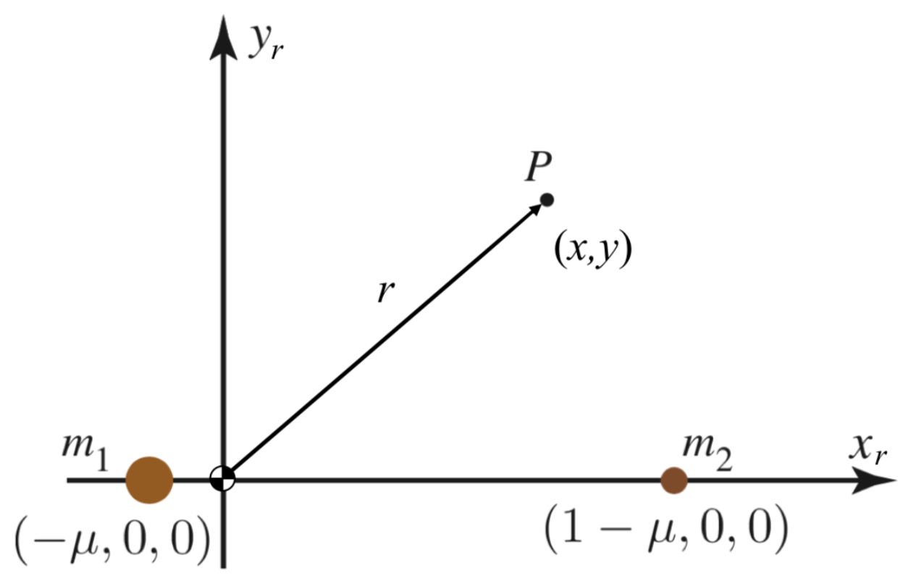
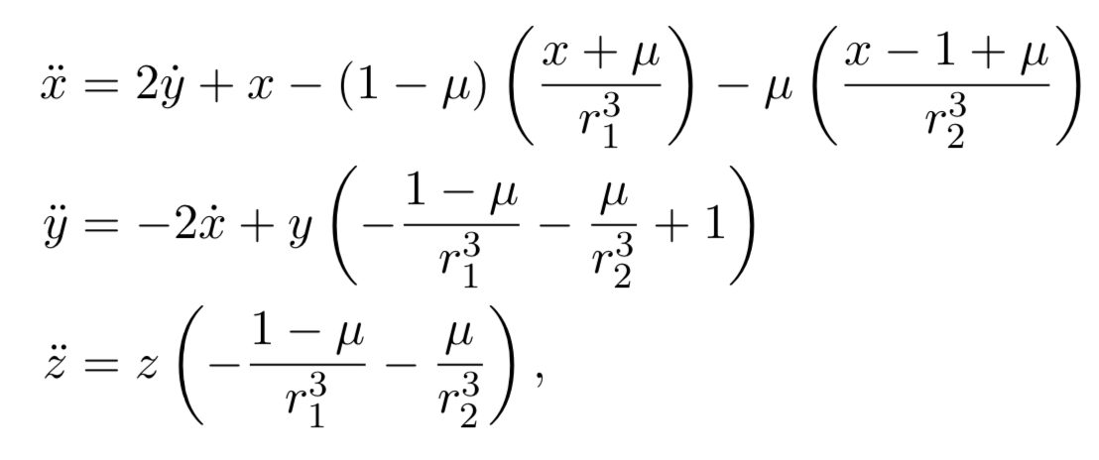
Circular Restricted Three Body Problem
Notes:
Circular, point mass…
Normalization: masses, a = 1, T = 2pi, G = 1

Slide 9
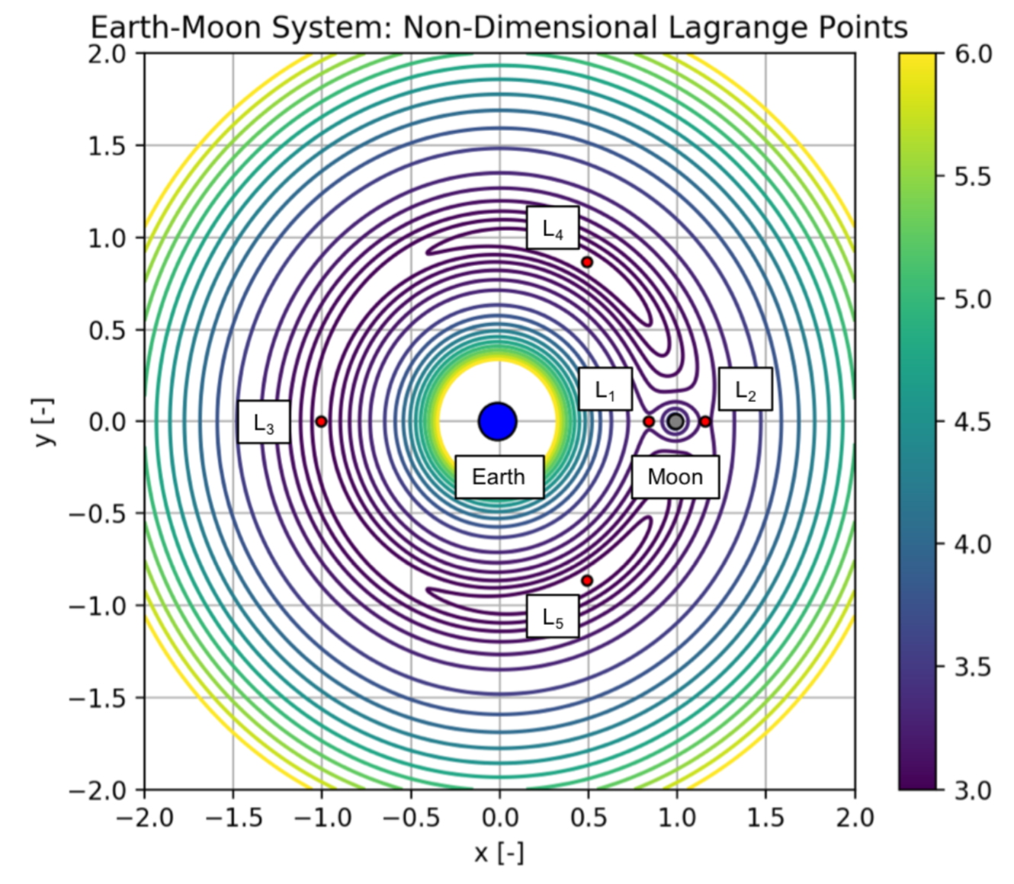
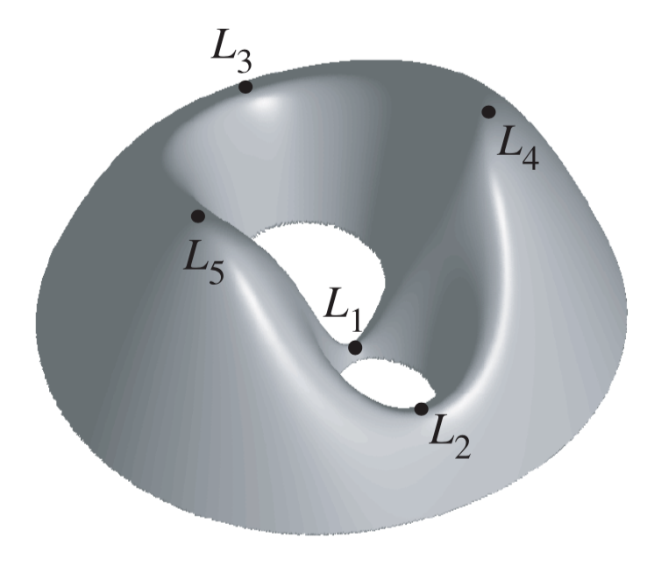
Equilibrium Points & Stability
[2]
Notes:
We don’t have cons of energy/momentum … we have the Jacobi constant
ZV curves
5 points (gravity and centripetal) – difficult to solve for
Saddle and Lyapunov stable
L4/L5 only stable for M1 > ~25*M2 … trojan asteroids

Slide 10
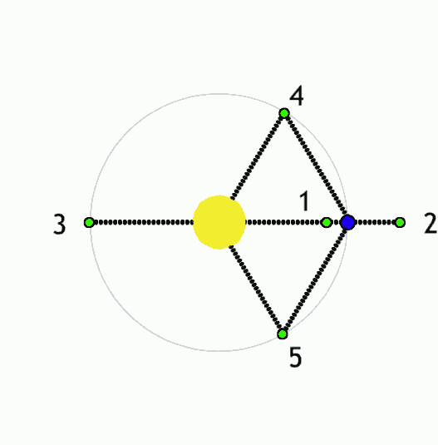
Equilibrium Points & Stability

Slide 11
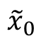
Periodic Orbits & Families
How do we find families of periodic orbits?
The Family Finding Algorithm of course!
y
$${\tilde{x}}_{0}$$
x

Slide 12
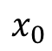
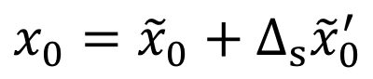
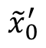
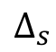
Periodic Orbits & Families
How do we find families of periodic orbits?
The Family Finding Algorithm of course!
y
$${\tilde{x}}_{0}^{′}$$
$$x_{0}={\tilde{x}}_{0}+Δ_{s}{\tilde{x}}_{0}^{′}$$
$$Δ_{s}$$
$$x_{0}$$
$${\tilde{x}}_{0}$$
x

Slide 13
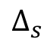
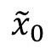
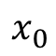
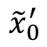
Periodic Orbits & Families
How do we find families of periodic orbits?
The Family Finding Algorithm of course!
y
$${\tilde{x}}_{0}^{′}$$
$$Δ_{s}$$
$$x_{0}={\tilde{x}}_{0}+Δ_{s}{\tilde{x}}_{0}^{′}$$
$$x_{0}$$
$${\tilde{x}}_{0}$$
x

Slide 14
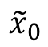
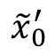
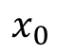
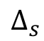
Periodic Orbits & Families
How do we find families of periodic orbits?
The Family Finding Algorithm of course!
y
$$x_{0}$$
$${\tilde{x}}_{0}^{′}$$
$$Δ_{s}$$
$$x_{0}={\tilde{x}}_{0}+Δ_{s}{\tilde{x}}_{0}^{′}$$
$${\tilde{x}}_{0}$$
x

Slide 15
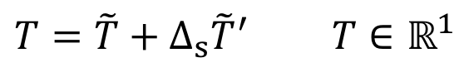
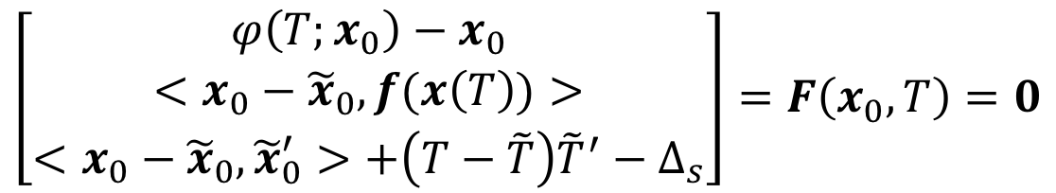
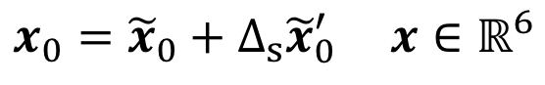
Periodic Orbits & Families
It gets a bit more complicated for periodic orbits.
Correction method uses a single shooter algorithm that solves the follow system of equations.
$$x_{0}={\tilde{x}}_{0}+Δ_{s}{\tilde{x}}_{0}^{′} x∈ℝ^{6}$$
$$T=\tilde{T}+Δ_{s}{\tilde{T}}^{′} T∈ℝ^{1}$$
Definition of periodic orbit
$$\left[\begin{matrix}φ\left(T;x_{0}\right)−x_{0} \\ <x_{0}−{\tilde{x}}_{0}, f(x\left(T\right))> \\ <x_{0}−{\tilde{x}}_{0},{\tilde{x}}_{0}^{′}>+\left(T−\tilde{T}\right){\tilde{T}}^{′}−Δ_{s}\end{matrix}\right]=F\left(x_{0},T\right)=0$$
Poincaré phase constraint
Pseudo-arclength continuation
Notes:
Poincare phase constraint lets us hone in on a single IC point of the infinitely many on the PO
Pseudo-arclength let us hone in on a single periodic orbit from the infinitely many in the family

Slide 16
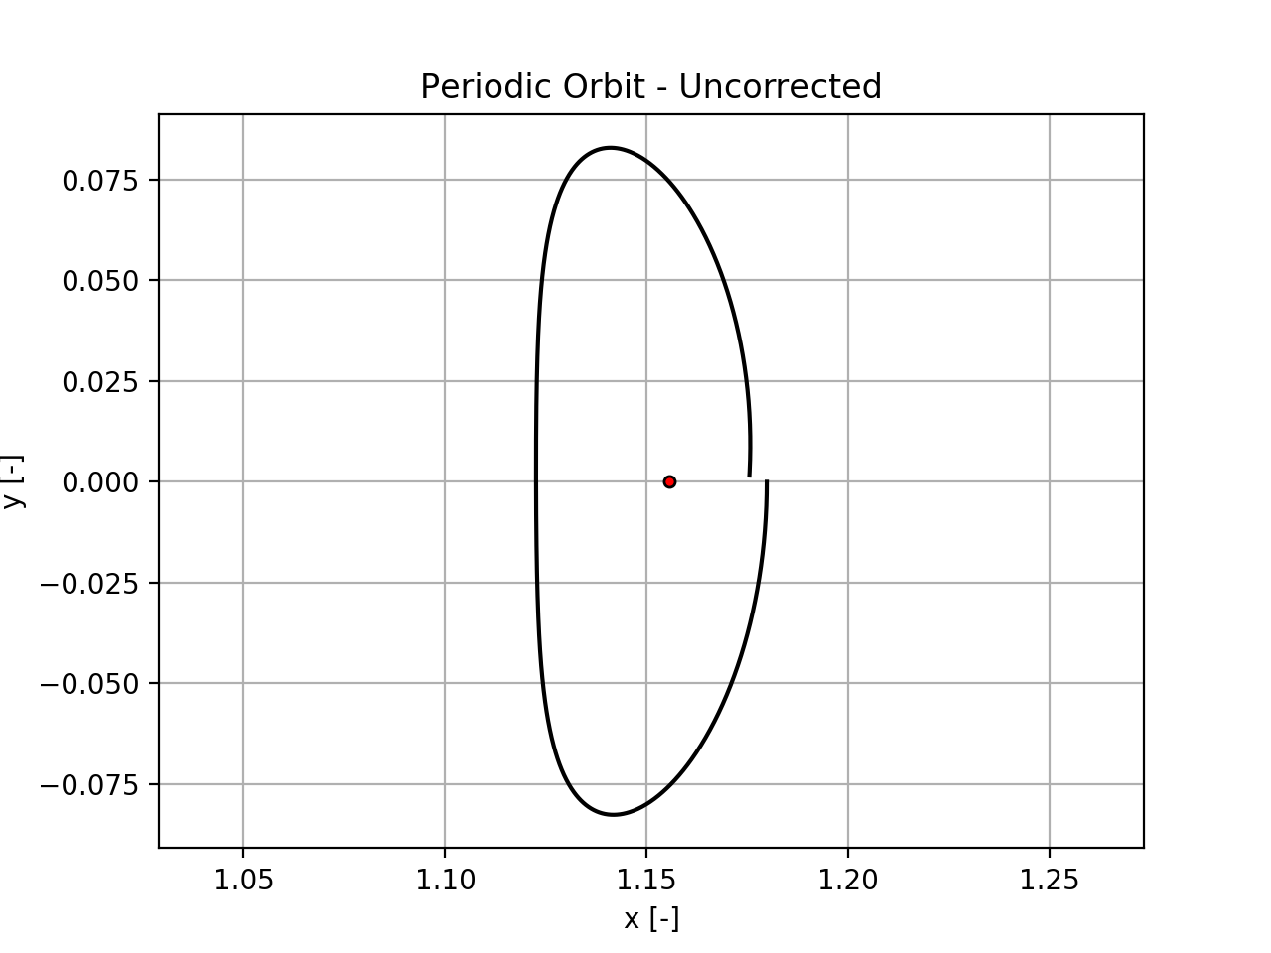
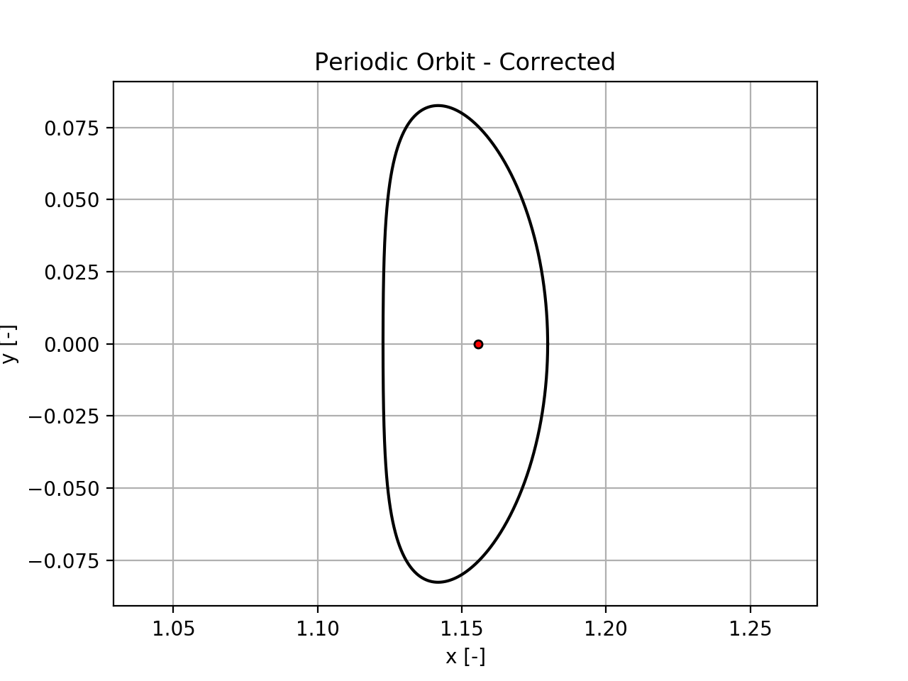
Periodic Orbits & Families

Slide 17
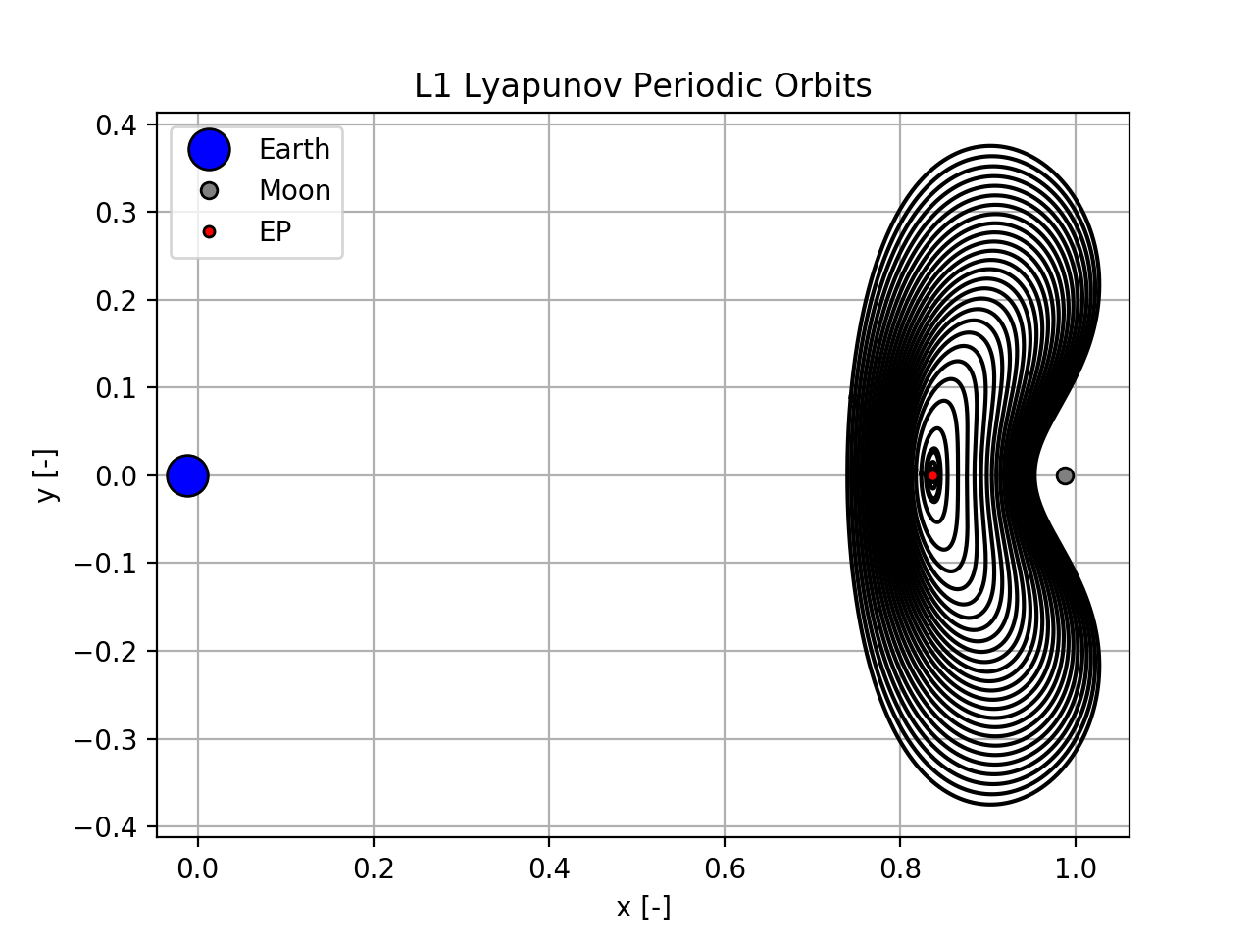
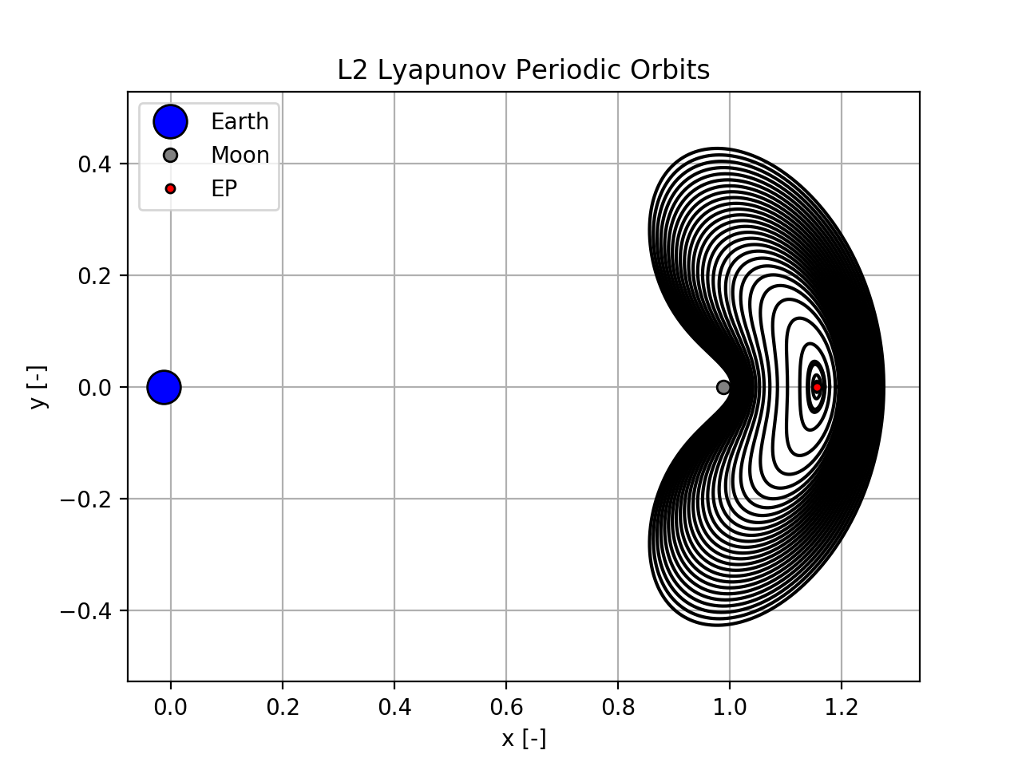
Periodic Orbits & Families

Slide 18
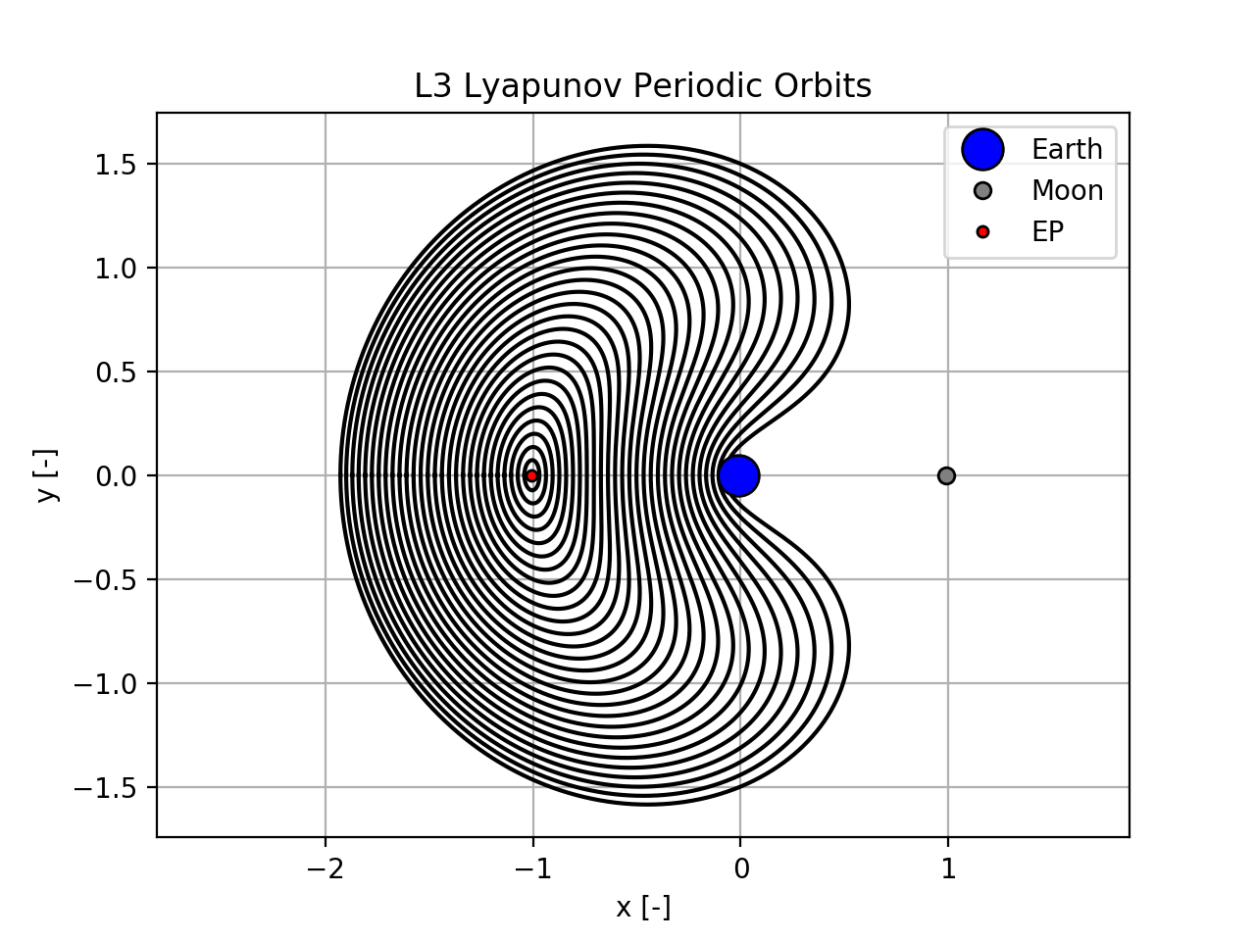
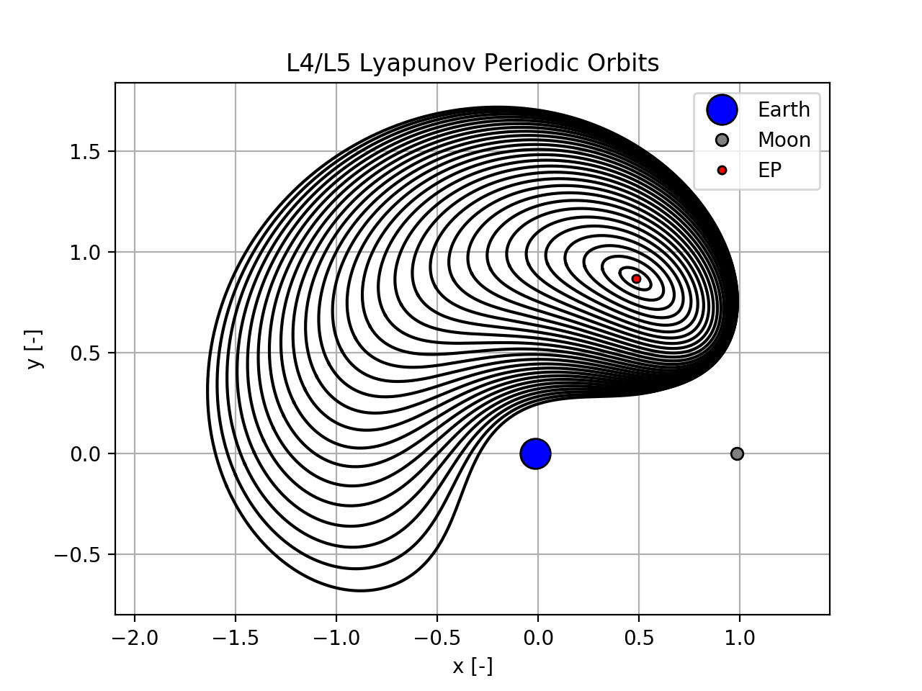
Periodic Orbits & Families

Slide 19
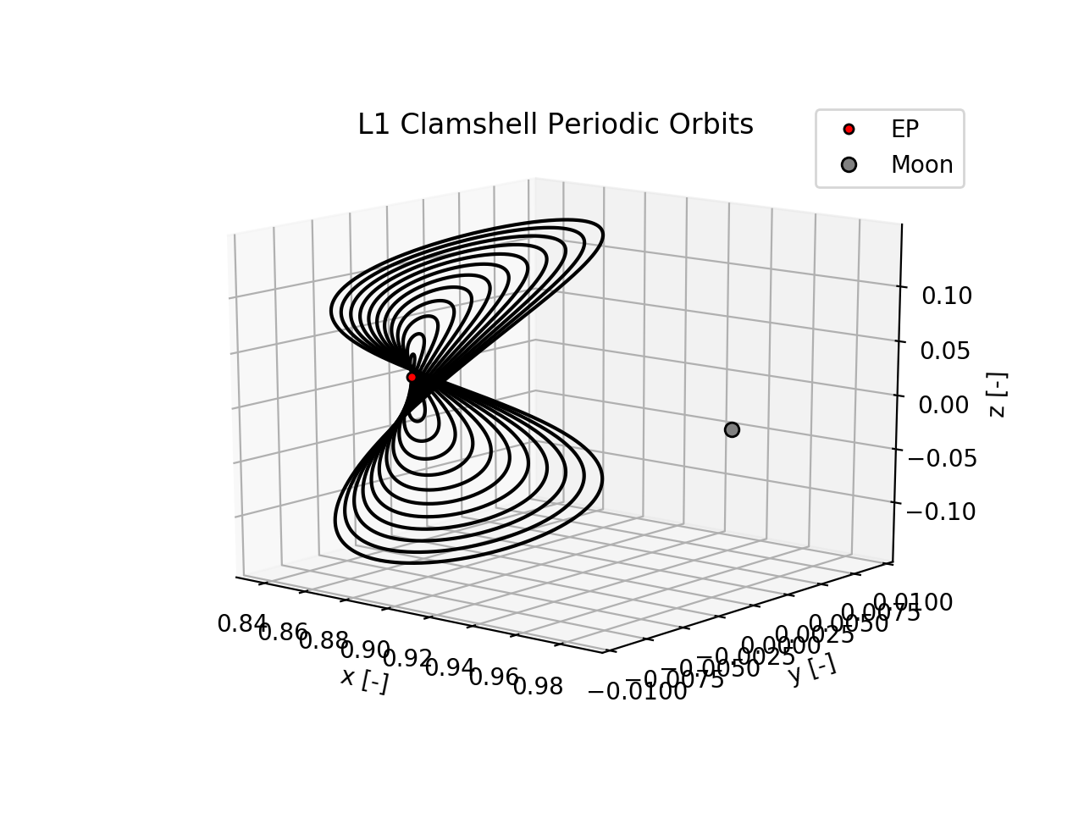
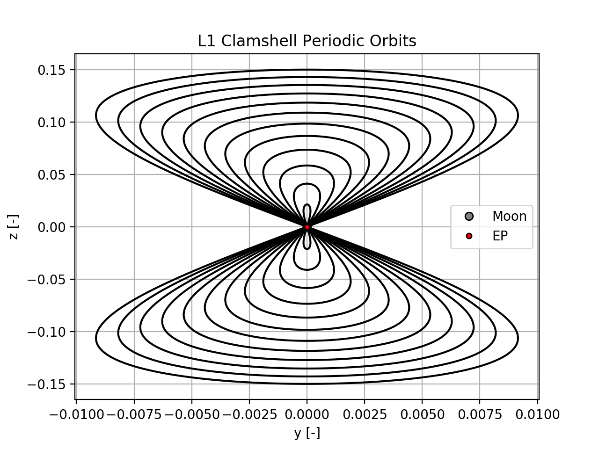
Periodic Orbits & Families

Slide 20
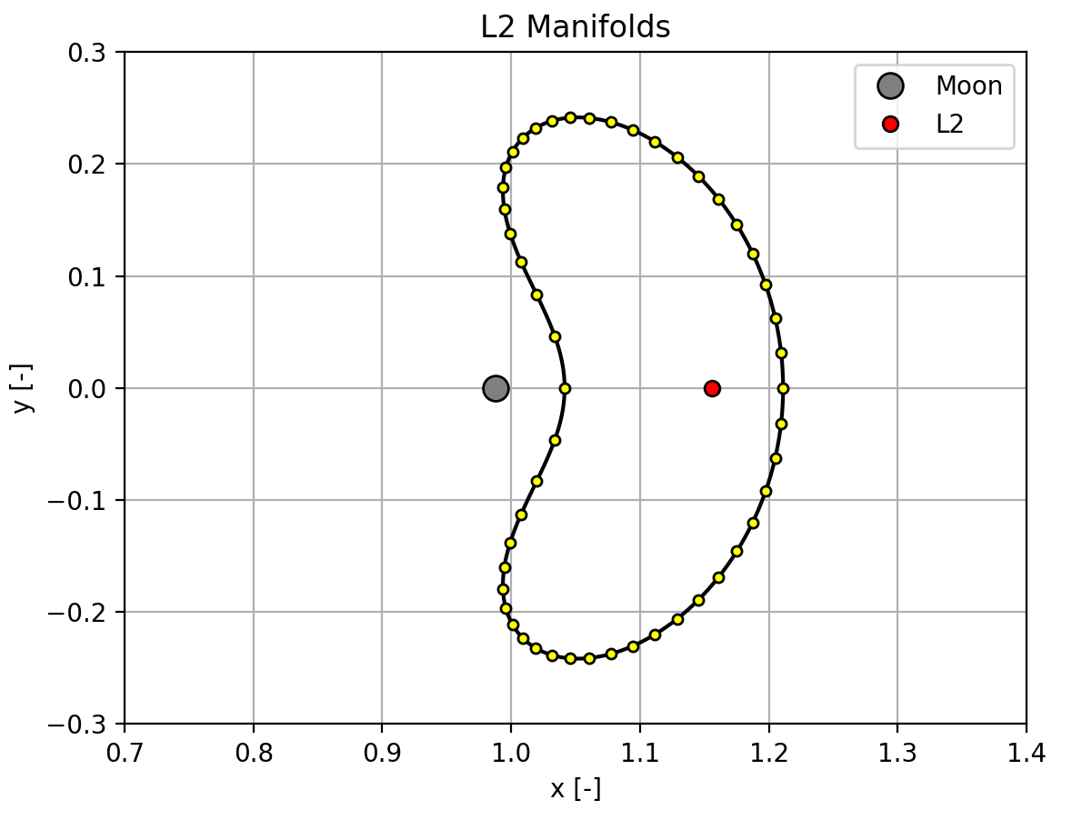
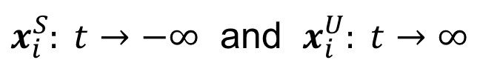
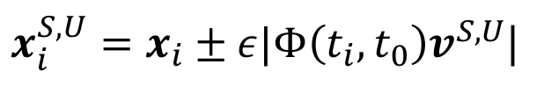
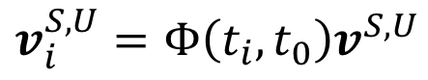
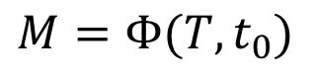
Periodic Orbit Stability & Manifolds
The stability of periodic orbits is determined from the Monodromy matrix.
$$M=Φ(T,t_{0})$$
$$v_{i}^{S,U}=Φ\left(t_{i},t_{0}\right)v^{S,U}$$
$x_{i}^{S,U}=x_{i}±ε|Φ\left(t_{i},t_{0}\right)v^{S,U}$|
$x_{i}^{S}: t→−∞$ and $x_{i}^{U}: t→∞$
Notes:
Discussion of how discretizing and nudging the PO in the stable/unstable direction then propagating backwards/forwards in time reveals manifolds

Slide 21
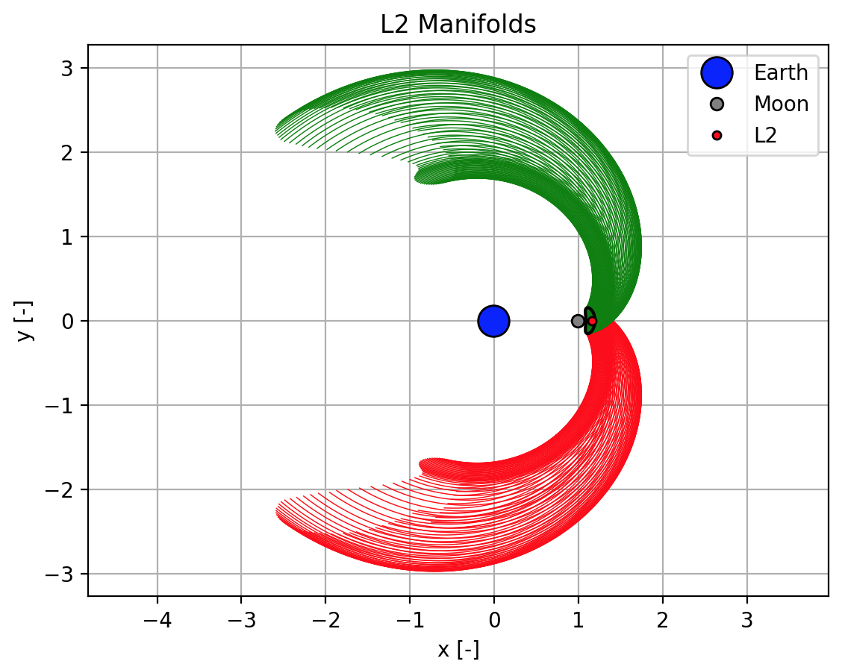
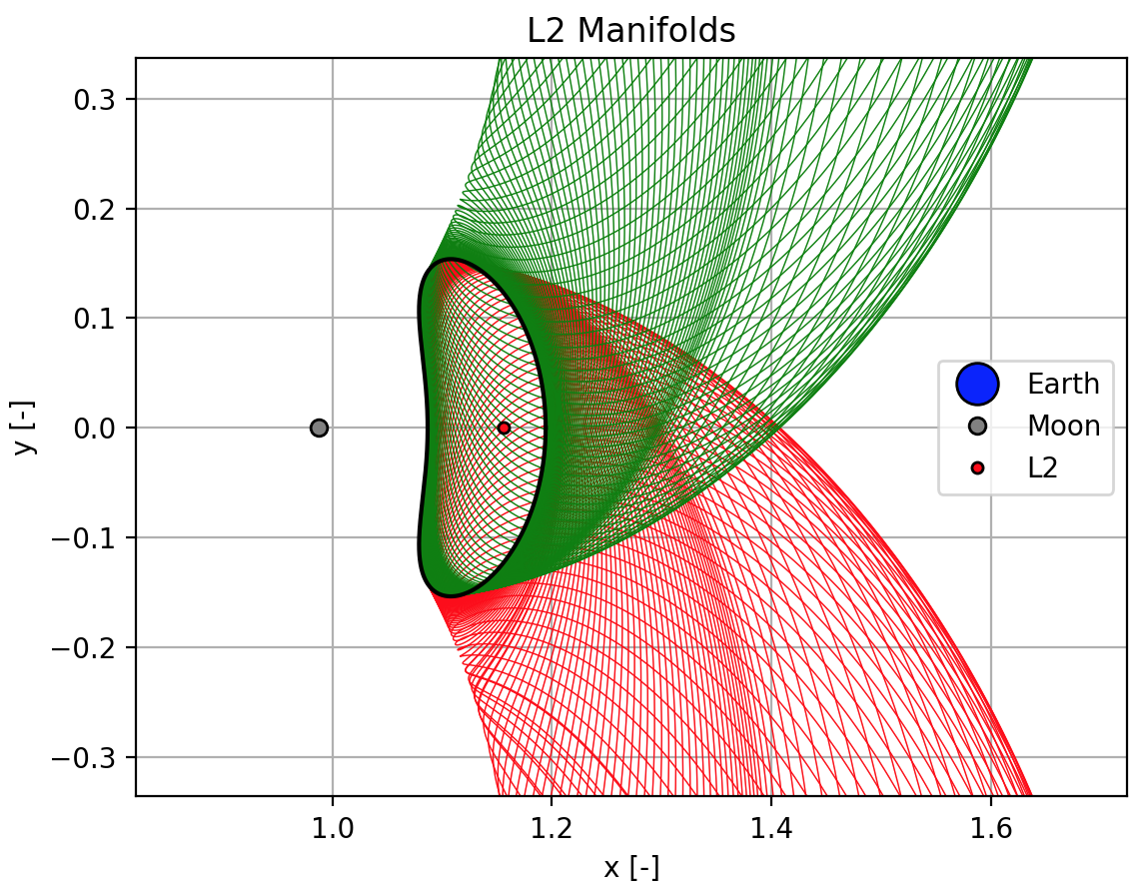
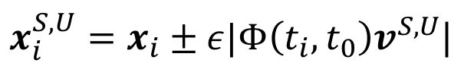
Periodic Orbit Stability & Manifolds
$x_{i}^{S,U}=x_{i}±ε|Φ\left(t_{i},t_{0}\right)v^{S,U}$|
Notes:
Here are the exterior stable and unstable manifolds for a periodic orbit about the L2 Lagrange point.
Each P.O. has interior and exterior stable and unstable manifolds.

Slide 22
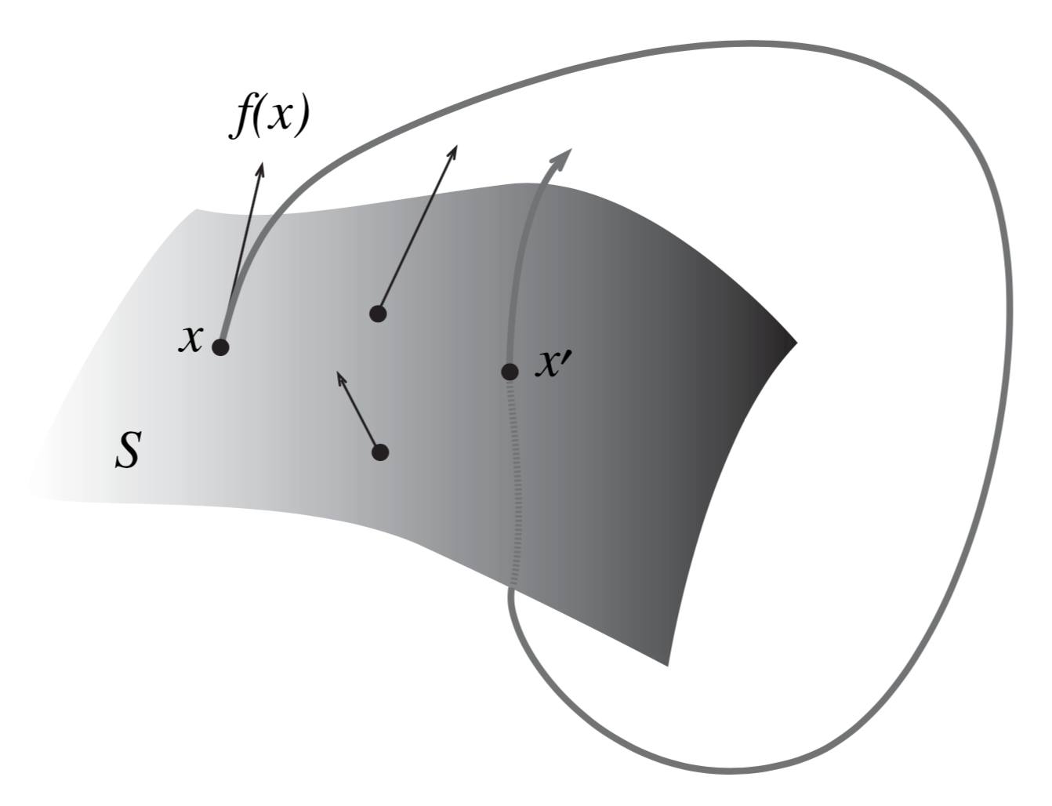
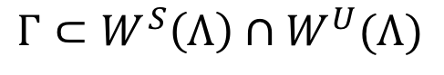
Poincaré Sections & Homoclinic Orbits
Homoclinic orbits occur at the intersection of the stable and unstable manifolds.
In order to find intersections, we use a Poincaré section.
$$Γ⊂W^{S}\left(Λ\right)∩W^{U}(Λ)$$

Slide 23
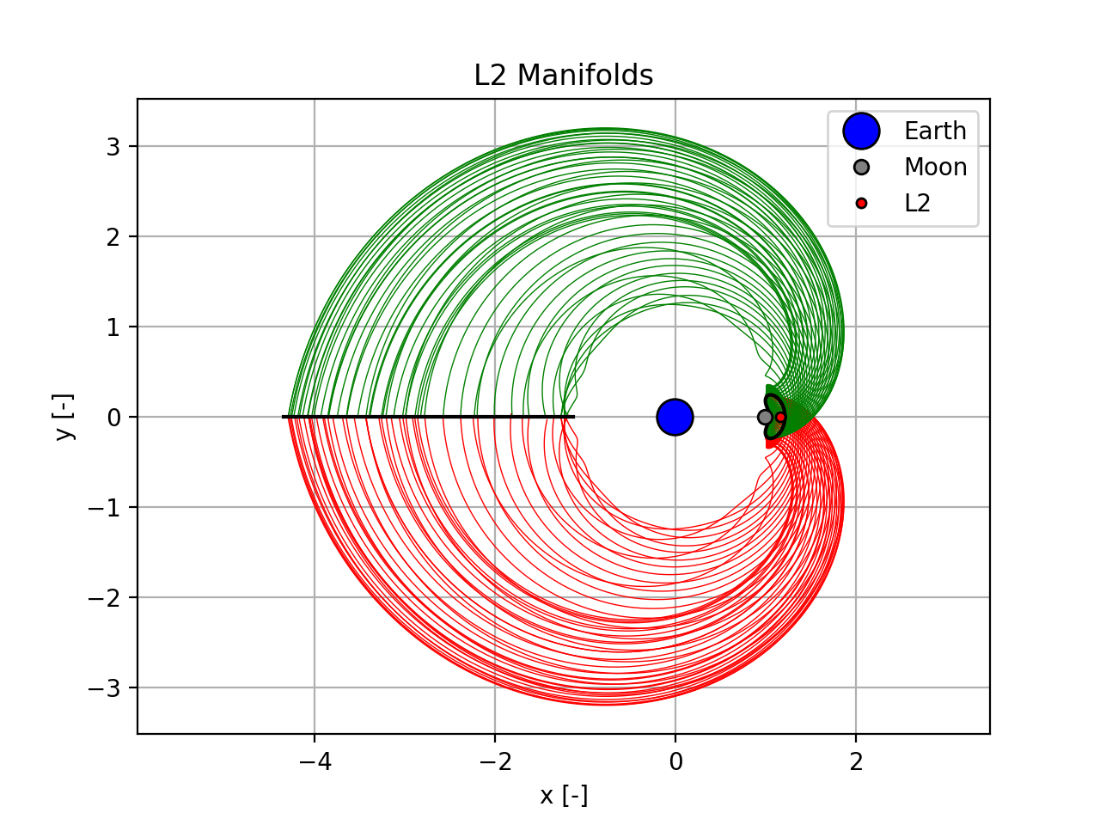
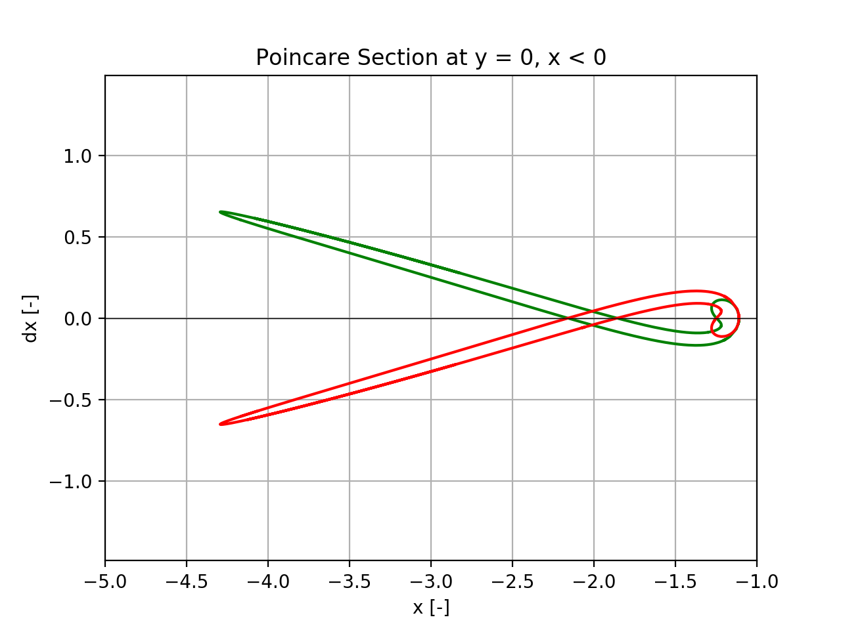
Poincaré Sections & Homoclinic Orbits
A common Poincaré section is y = 0, x < 0 for the exterior L₂ manifolds.

Slide 24
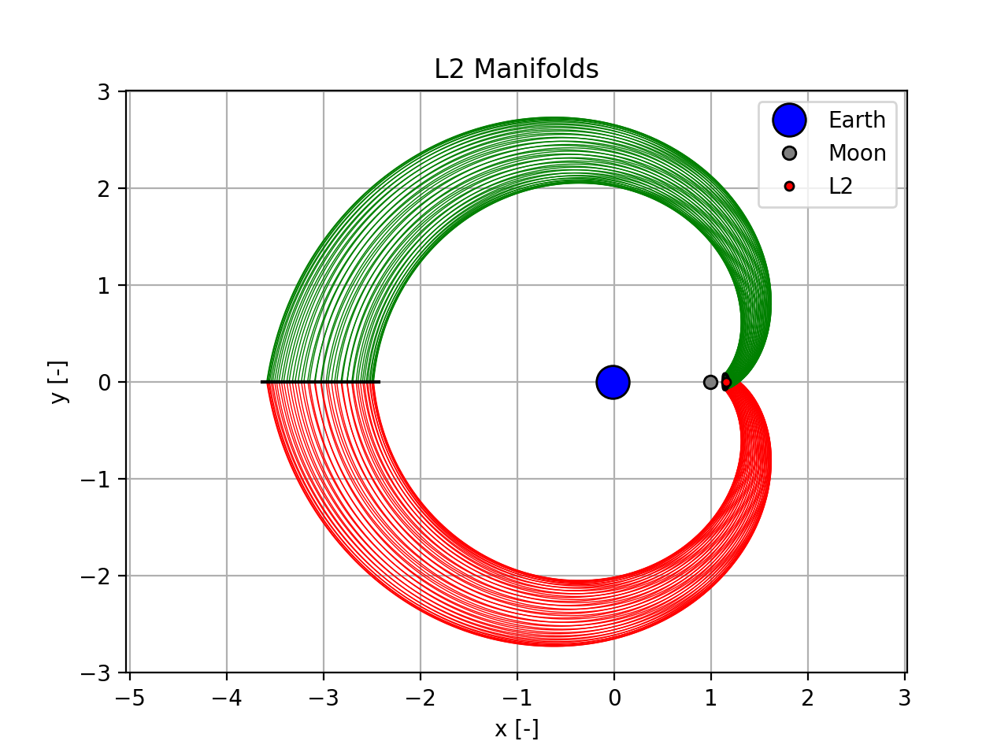
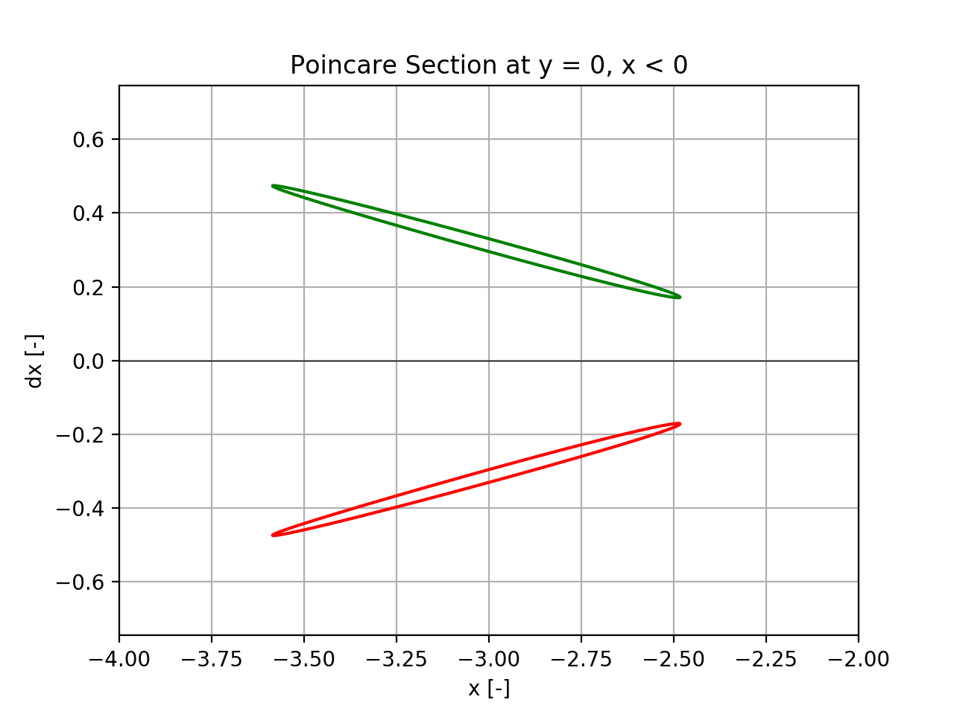
Poincaré Sections & Homoclinic Orbits
Not every periodic orbit has homoclinic orbits!

Slide 25
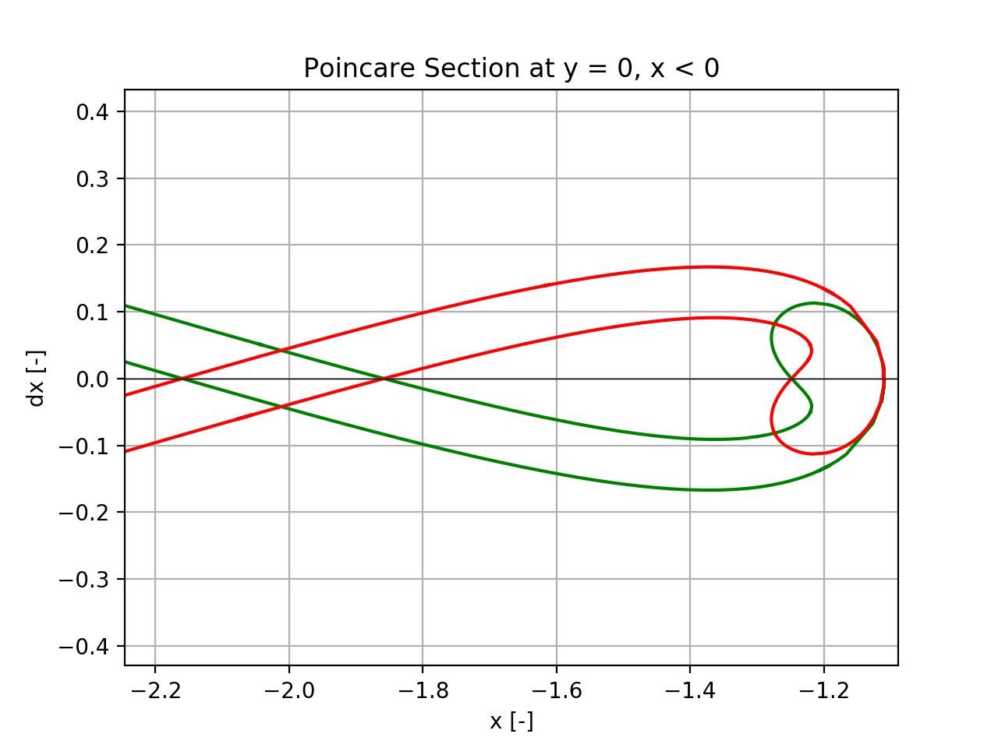
Poincaré Sections & Homoclinic Orbits
Intersection of the stable and unstable manifolds on the Poincaré section correspond to homoclinic orbits.
Notes:
Line dx = 0 are symmetric homoclinic orbits
Other are asymmetric orbits

Slide 26
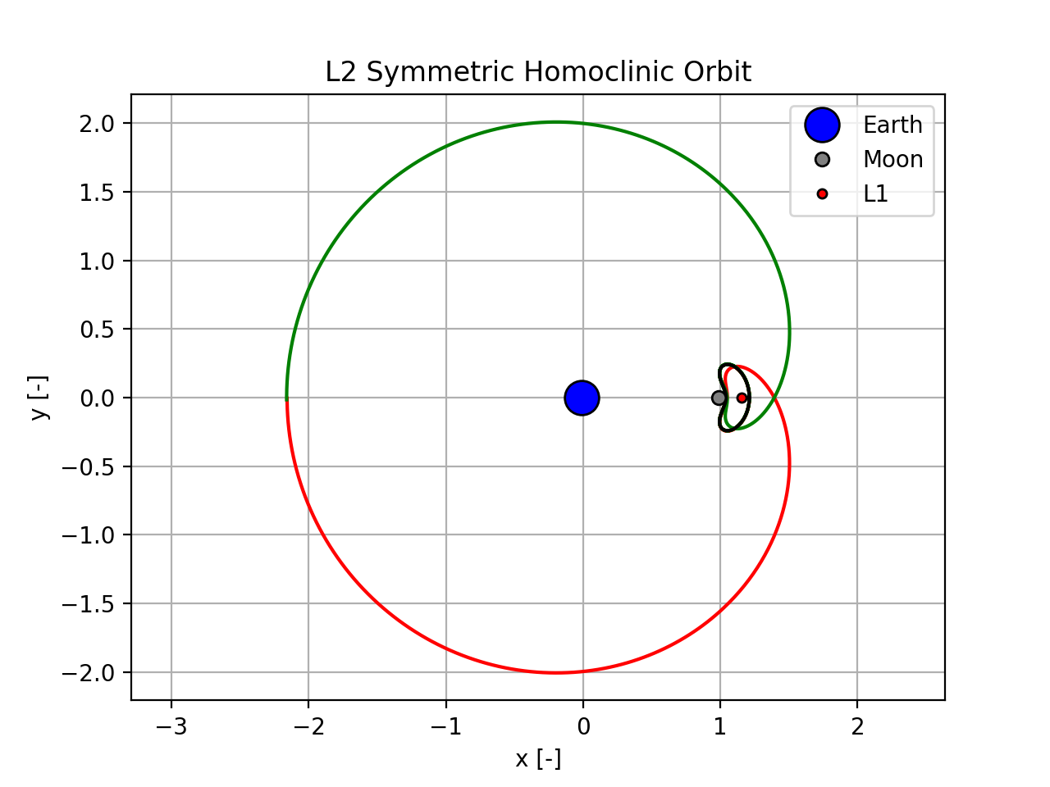
Poincaré Sections & Homoclinic Orbits

Slide 27
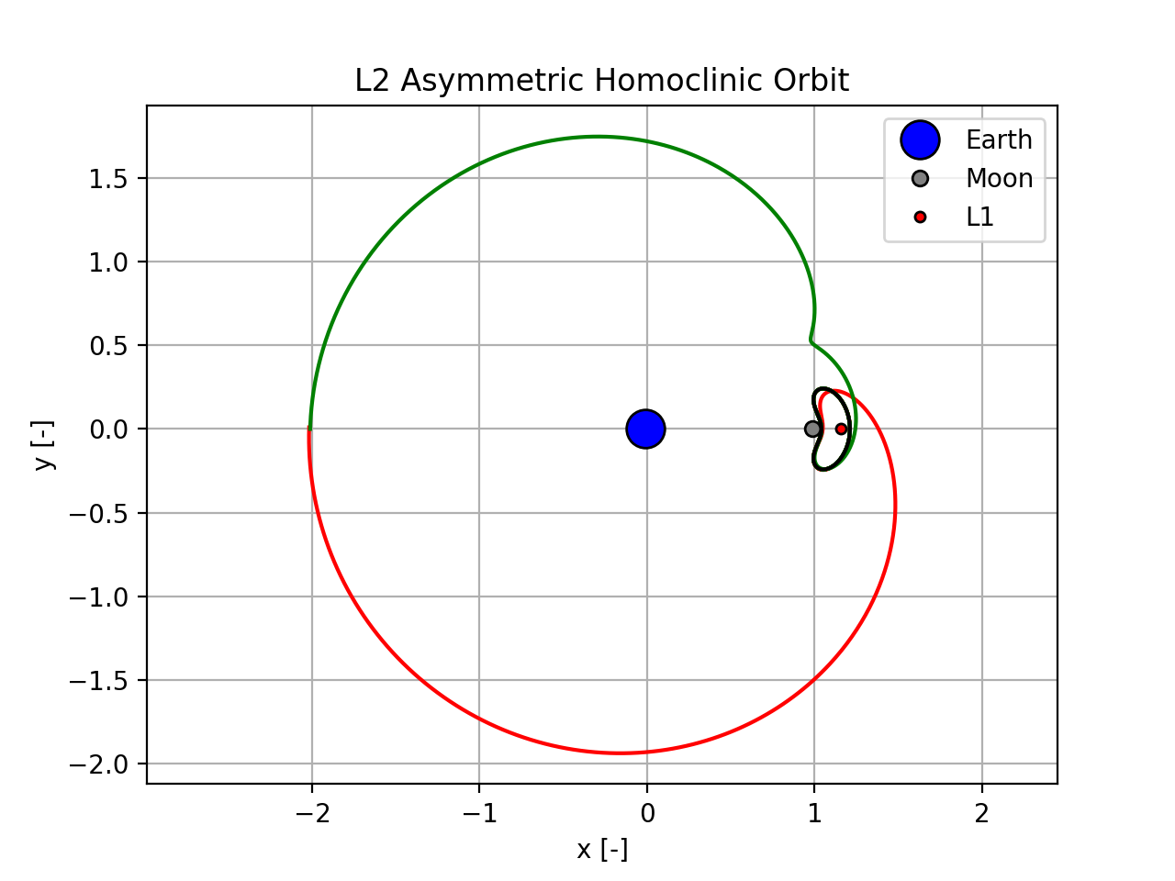
Poincaré Sections & Homoclinic Orbits

Slide 28


Significance and Usefulness of Homoclinic Orbits
Understand the flow of dynamic systems
For mission design, heteroclinic are generally more valuable
Notes:
-Homoclinic orbits can help understand flow of dynamic system, but for mission design, heterclinic orbits are of much greater use (moon transfers, etc)
-Can cite some papers

Slide 29


Questions

Slide 30
Extra Slides

Slide 31





Starting FFA
Lyapunov Center Theorem
Use eigenvalue and eigenvectors of center manifold of Df*
$$εv_{1}$$
$$v=v_{1}+iv_{2}$$
$$T=\frac{2π}{λ}$$
$$x^{∗}$$
$$εv_{2}$$

Slide 32
References
[1] https://en.wikipedia.org/wiki/Henri_Poincare
[2] W. S. Koon, M. W. Lo, J. E., Marsden, and S. D. Ross. Dynamical Systems, The Three-Body Problem, and Space Mission Design. Marsden Books, 2011

